Slide 1


COMPLETE & BALANCED
ZÓÓSH
PERFORMER
PREMIUM CANINE NUTRITION
IDEAL FOR WORKING DOGS
(ALL BREEDS / ALL LIFE STAGES)

Slide 2
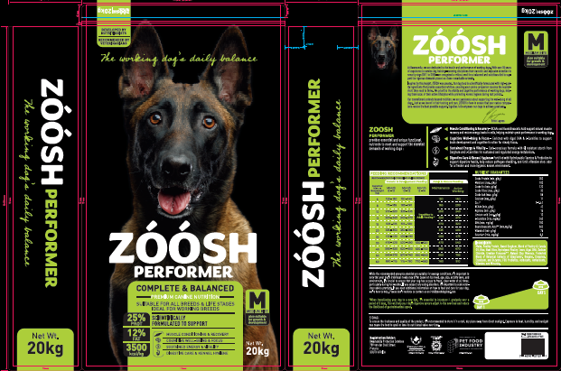


About us
ZÓÓSH Performer was inspired by Kwamandla, a trusted South African service dog training organization with over 35 years of experience in developing disciplined, high-performance working dogs. Through their deep understanding of canine performance, Kwamandla recognized a critical need for a balanced and nutritious diet to support the rigorous physical and mental demands placed on working and athletic dogs.
Nutritionhub (Pty) Ltd, is a nutritional consultancy dedicated to providing trusted technical support and innovative, sustainable solutions in the pet food and animal nutrition sector.
Together with Kwamandla laid the foundation for ZÓÓSH Performer — a premium, scientifically formulated diet designed to support optimal health and performance in companion animals.

Slide 3

The nutrition essence
SCIENTIFICALLY FORMULATED
At Kwamandla, we are dedicated to the health and performance of working dogs. With over 35 years of experience in servicing dog training-covering disciplines from narcotic and explosive detection to security dogs (DH1 to DH5)- we recognized a critical need for a balanced and nutritious diet to support the rigorous demands placed on these remarkable animals.
Inspired by this insight, ZÓÓSH was created. Our dog food is scientifically formulated with high quality ingredients that provide essential nutrition, ensuring your canine companion receives the nourishment they need to thrive. We prioritize the vitality and cognitive performance of working dogs, helping them excel in their active lifestyles while promoting kennel hygiene during rest periods.
Our commitment extends beyond nutrition; we are passionate about supporting the well-being of all dogs. Just as we invest in their training and care. ZÓÓSH is here to ensure that your canine companion receive the best possible support. Together, let’s empower our dogs to achieve greatness
20244
20254
ZÓÓSH – Fueling Strength, Sharpening Minds, Empowering Dogs

Slide 4

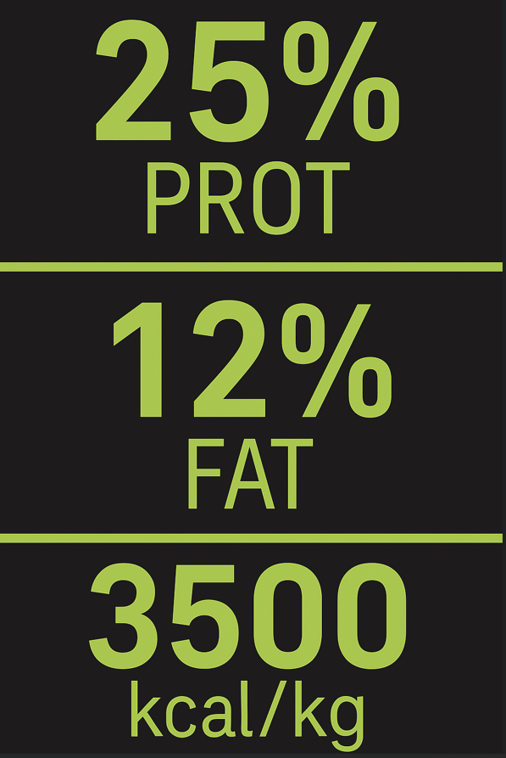

COMPLETE & BALANCED
SCIENTIFICALLY FORMULATED
Supports lean muscle development and maintenance
Fuel sustained activity and promote optimal body condition in active dogs
Supports high energy demands of active and working dogs
Formulated with precision to deliver a complete and balanced profile of essential nutrients, supporting overall wellbeing and peak performance
The working dog’s daily balance

Slide 5
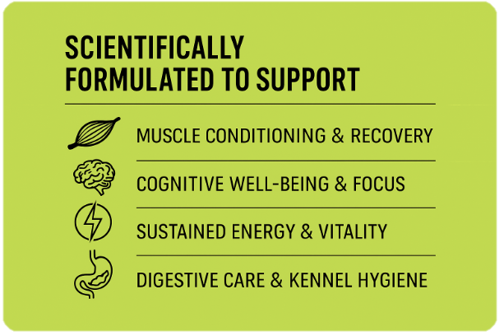
UNIQUE FUNCTIONAL BENEFITS
THE ZÓÓSH DIFFERENCE
Adding health –supporting benefits, beyond nutritional balance or fortification
The working dog’s daily balance

Slide 6
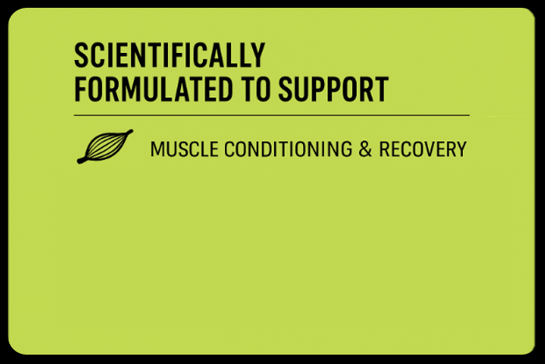

The zÓÓsh difference
UNIQUE FUNCTIONAL BENEFITS
MUSCLE CONDITIONING & RECOVERY
BCAAs |
GUANDINOACTIC ACID
Support Muscle Growth and Repair
Reduce Muscle Breakdown during physical activity
Support muscle recovery
Supports Muscle Growth and Maintenance
Enhances muscle recovery
Ideal for high-performing and working dogs
BCAAs and creatine support muscle strength, reduce fatigue, and boost recovery—keeping your dog active and healthy
The working dog’s daily balance

Slide 7






The zÓÓsh difference
UNIQUE FUNCTIONAL BENEFITS
ALGAL DHA
Promotes healthy brain activity to support memory and concentration
Contains bioactive compounds that help protect brain cells and support cognitive function
Sustainable and plant-based omega-3 source (non-fish)
L-CARNITINE
Algal DHA and L-Carnitine support brain development, memory, and learning, while helping convert fat into energy—promoting both cognitive and physical vitality in dogs
Supports energy production by converting fat into fuel for cells
Supports brain energy metabolism, for improve memory and learning capacity
Supports healthy aging by helping protect brain cells over time
The working dog’s daily balance

Slide 8


The zÓÓsh difference
UNIQUE FUNCTIONAL BENEFITS
SORGHUM
Slow energy release for sustained energy
Contains vitamin B6 to support energy metabolism
Supports healthy digestion for nutrient absorption
Sorghum provides slow-releasing carbohydrates for long-lasting energy, while L-Carnitine helps convert fat into fuel—together supporting sustained energy, stamina, and vitality in active dogs
L-CARNITINE
Supports energy production by converting fat into fuel for stamina and endurance,
Helps reduce fatigue during physical activity
Supports heart and muscle health
The working dog’s daily balance

Slide 9




The zÓÓsh difference
UNIQUE FUNCTIONAL BENEFITS
PYTOGENICS
Supports a healthy gut environment
Natural antioxidant — protects the gut lining
Supports digestive health by improving stool consistency and quality
Helps reduce diarrhea and digestive upsets, supporting better kennel hygiene improving overall sanitary conditions in group housing environments
Phytogenic extracts promotes digestive health by supporting gut integrity and reducing harmful microbes, while also improving stool quality—contributing to better kennel hygiene and overall well-being in dogs
The working dog’s daily balance

Slide 10
The zÓÓsh difference
Ingredients | Essential nutrients | Energy | Digestive Health | Cognitive health | Stool Quality | Skin and coat Health | Gut Microbiome
Maize | x | x
Poultry meal | x
Sorghum | x | x
Poultry & canola oil | x | x |  |  |  | X
Rice | x | x
Beet Fibre |  |  | x |  |  |  | x
Vitamins & minerals | x
DHA Gold |  |  |  | x |  | x
Creatine |  | x |  | x
L-Carnitine |  | x |  | x
Farmatan |  |  | x |  |  |  | x
The working dog’s daily balance

Slide 11





VETERINARY recommended
Formulated to standard
Developed in accordance with the regulatory requirements of Act 36 of 1947, ensuring compliance with South African agricultural and veterinary product standards
Formulated in compliance with the nutritional and safety guidelines set by FEDIAF (European Pet Food Industry Federation), ensuring adherence to internationally recognized standards of pet food quality and excellence
Formulated in accordance with the nutritional standards and regulatory guidelines established by AAFCO (Association of American Feed Control Officials), ensuring compliance with recognized benchmarks for pet food safety and nutritional adequacy
Regulatory Compliant
ZÓÓSH has been developed in compliance with recognised formulation standards, under the expert guidance of NutritionHub to ensure optimal quality, safety, and efficacy
Industry Compliant
Formulated in compliance with the regulatory standards of the Pet Food Industry (PFI), ensuring adherence to industry best practices in quality, safety, and nutritional excellence

Slide 12

ZÓÓSH
PERFORMER
THE DIFFERENCE
PREMIUM CANINE NUTRITION

Slide 13
COMPLETE & balanced
SCIENTIFICALLY
FORMULATED
Maize
Provides sustained energy through complex carbohydrates, delivers essential nutrients like linoleic acid, and supports energy metabolism with B-vitamins and antioxidants
Ingredients | Essential nutrients | Energy | Digestive Health | Cognitive health | Stool Quality | Skin and coat Health | Gut Microbiome
Maize | x | x
Poultry meal | x
Sorghum | x | x
Poultry & canola oil | x | x |  |  |  | X
Poultry protein
A valuable protein source, rich in essential amino acids such as leucine, lysine, and methionine, which are critical for skeletal muscle synthesis, post-exercise recovery, and meeting the elevated metabolic demands
Poultry & canola blend:
Provide a complementary nutrient profile—offering essential amino acids such as leucine, lysine, and methionine, along with unsaturated fatty acids including oleic, linoleic, and alpha-linolenic acids to support muscle protein synthesis, modulate inflammation, and promote efficient energy metabolism
Poultry livers:
A nutrient-dense organ meat rich in highly bioavailable protein, iron, vitamin A, B-complex vitamins (particularly B12 and folate), and essential trace minerals, supporting red blood cell production, immune function, and overall metabolic efficiency
The working dog’s daily balance

Slide 14
COMPLETE & balanced
SCIENTIFICALLY
FORMULATED
Rice
A highly digestible starch source with a low fiber, providing rapidly absorbable glucose that supports glycogen resynthesis, intestinal tolerance, and sustained metabolic output
Ingredients | Essential nutrients | Energy | Digestive Health | Cognitive health | Stool Quality | Skin and coat Health | Gut Microbiome
Rice | x | x
Beet Fibre | x |  | x
Algal DHA | x |  |  | x |  | x
Sodium Chloride | x
Beet fibre
A source of moderately fermentable insoluble and soluble fibres that promote colon fermentation of short-chain fatty acids such as butyrate, a key energy source for colonocytes thereby supporting colonic epithelial integrity, nutrient absorption, and fecal consistency
Algal DHA
A concentrated source of bioactive nucleotides, algal DHA is known to support cognitive function, immune regulation, cellular regeneration, and anti-inflammatory pathways. It contributes to enhanced vitality, optimal neurological development, and sustained long-term health
Sodium Chloride
Sodium chloride is a vital electrolyte that supports hydration, nerve function, and nutrient absorption, helping maintain electrolyte balance and overall health
The working dog’s daily balance

Slide 15
COMPLETE & balanced
SCIENTIFICALLY
FORMULATED
Creatine
A naturally occurring compound that supports high-intensity energy metabolism by regenerating adenosine triphosphate (ATP) in muscle and brain tissue, enhancing strength, endurance, and cognitive resilience
Ingredients | Essential nutrients | Energy | Digestive Health | Cognitive health | Stool Quality | Skin and coat Health | Gut Microbiome
Creatine | x | x |  | x
Ellagitannin | x |  | x |  |  |  | x
Oregano | x |  | x |  |  |  | x
Cinnamon | x |  | x
Ellagitannin
Powerful polyphenols that support antioxidant defense, anti-inflammatory activity, and gut health. They release ellagic acid during digestion, aiding in cellular protection and immune modulation
Oregano
A natural herb rich in phenolic compounds like carvacrol and thymol, known for their antimicrobial, antioxidant, and anti-inflammatory properties to support digestive health, and helps reduce pathogenic bacterial load in the gut
Cinnamon
Rich in bioactive compounds such as cinnamaldehyde, offering antioxidant, anti-inflammatory, and antimicrobial benefits that support metabolic health and digestive function
The working dog’s daily balance

Slide 16
COMPLETE & balanced
SCIENTIFICALLY
FORMULATED
Capsicum
Provides capsaicinoids, primarily capsaicin, which influence inflammatory pathways, stimulate metabolic activity, and exert antioxidant and antimicrobial effects
Butyrate
a short-chain fatty acid that supports gut barrier integrity, immune regulation, and serves as a key energy source for colon cells, promoting intestinal health
Ingredients | Essential nutrients | Energy | Digestive Health | Cognitive health | Stool Quality | Skin and coat Health | Gut Microbiome
Capsicum |  |  |  | x | x |  | x
Buyterate |  |  | x |  |  |  | x
Prebiotics |  |  | x |  | x |  | x
Vitamins and Minerals | x | x | x | x |  | x
Natural Clay Minerals |  |  | x |  | x
Prebiotics
Soluble prebiotics that selectively stimulate beneficial gut microbiota, particularly Bifidobacteria and Lactobacilli, promoting intestinal health, improved digestion, and enhanced immune functio
Vitamins and minerals
critical micronutrients that support energy metabolism, muscle function, bone strength, and immune resilience—helping maintain performance, recovery, and overall health
Natural clay minerals
Contains zeolites and bentonites, which act as adsorbents, binding dietary toxins and pathogenic microbes, thereby supporting gut health and reducing stool odor
The working dog’s daily balance

